Slide 1


Slide 2
Background
The advancement of mobile applications that cater to the need for smooth access and doorstep delivery services resulted in their dominance in the market as well as a consistently growing patronage among mobile users. These mobile applications, like online shopping and food delivery services, greatly help in easing the workload of many users who cannot afford to take time and physically travel to accomplish their everyday tasks.

Slide 3
Background
Similarly, many students and employees at the University of the Philippines Los Baños (UPLB) are currently experiencing a hard time to accomplish multiple errands due to their hectic academic schedules and personal commitments. On the other hand, various students and employees are experiencing difficulties in terms of their budget and financial needs. As a result, they opt to look for freelance labor that could help them augment their budget and gain additional income. These include services such as tutoring, proofreading, transcribing, cleaning, selling, and the likes. Currently, transactions being made by students and employees with their clients do not follow a standard transaction platform.

Slide 4
Statement of the Problem
UPLB students and employees use social media to post errands that need to be done or services that they offer. However, there are multiple online platforms to choose from, such as Facebook, Twitter, and the likes. Since not all students or employees use all platforms, some posted errands may be missed by someone who would have been a good fit. Also, most of the existing crowdsourcing mobile applications are not yet available to the UPLB community and not centered on its contexts and activities. Thus, a dedicated platform for such posts, limited to UPLB students and employees, would streamline this process.

Slide 5
Objectives
The main objective of this study was to design and create a user-friendly errand crowdsourcing mobile application for UPLB students and employees. Moreover, this study specifically aimed:
to develop a mobile application for Android using Flutter and Firebase; and;
to test the mobile application to UPLB students and employees with UP Mail.

Slide 6
Significance
The mobile application developed served as an accessible platform for many college students and employees who need help in looking for extra income, as well as those who would like to request for assistance regarding their errands or school and work-related requirements. It will also be mutually beneficial for both parties as it would satisfy the former for its financial needs. At the same time, it would help the latter by making sure that their other tasks are accomplished despite their hectic schedules.

Slide 7
An Errand Crowdsourcing Mobile Application for UPLB Community

Slide 8
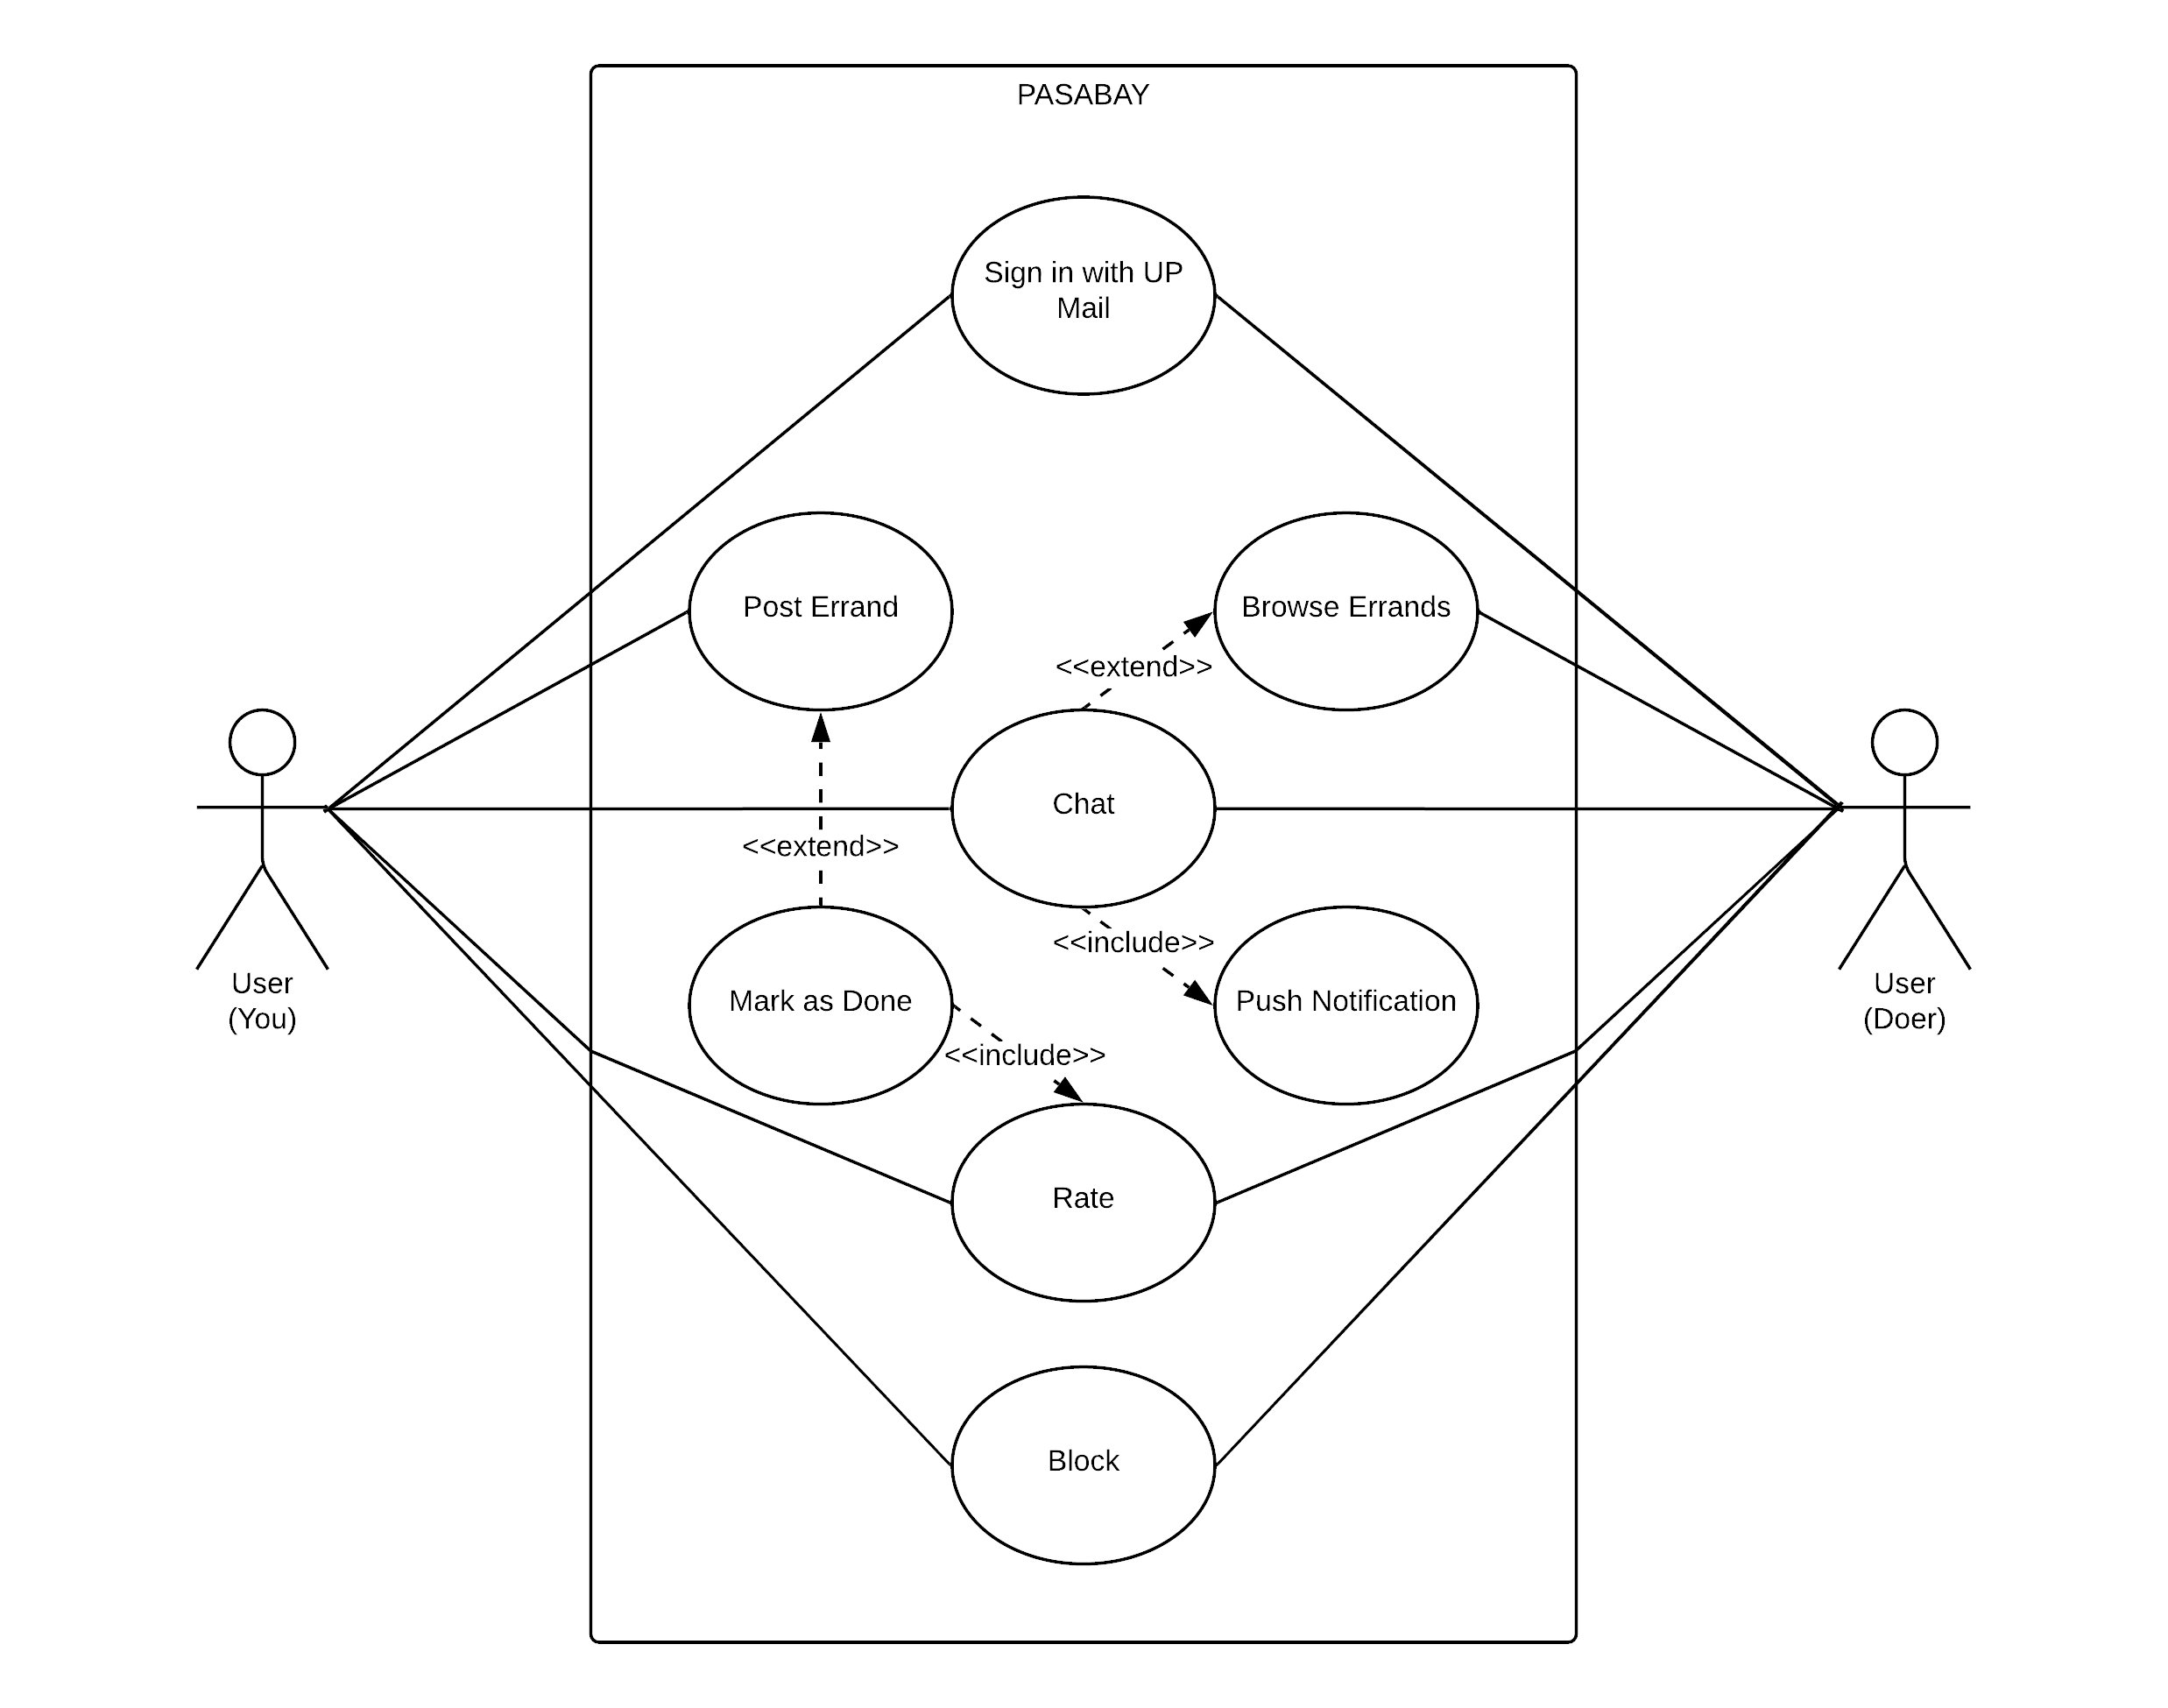
Functionalities
The mobile application requires at least two (2) users. The following are the general functionalities implemented in the app:
Sign in with UP Mail
Post Errand
Browse Errands
Chat
Rate
Block

Slide 9
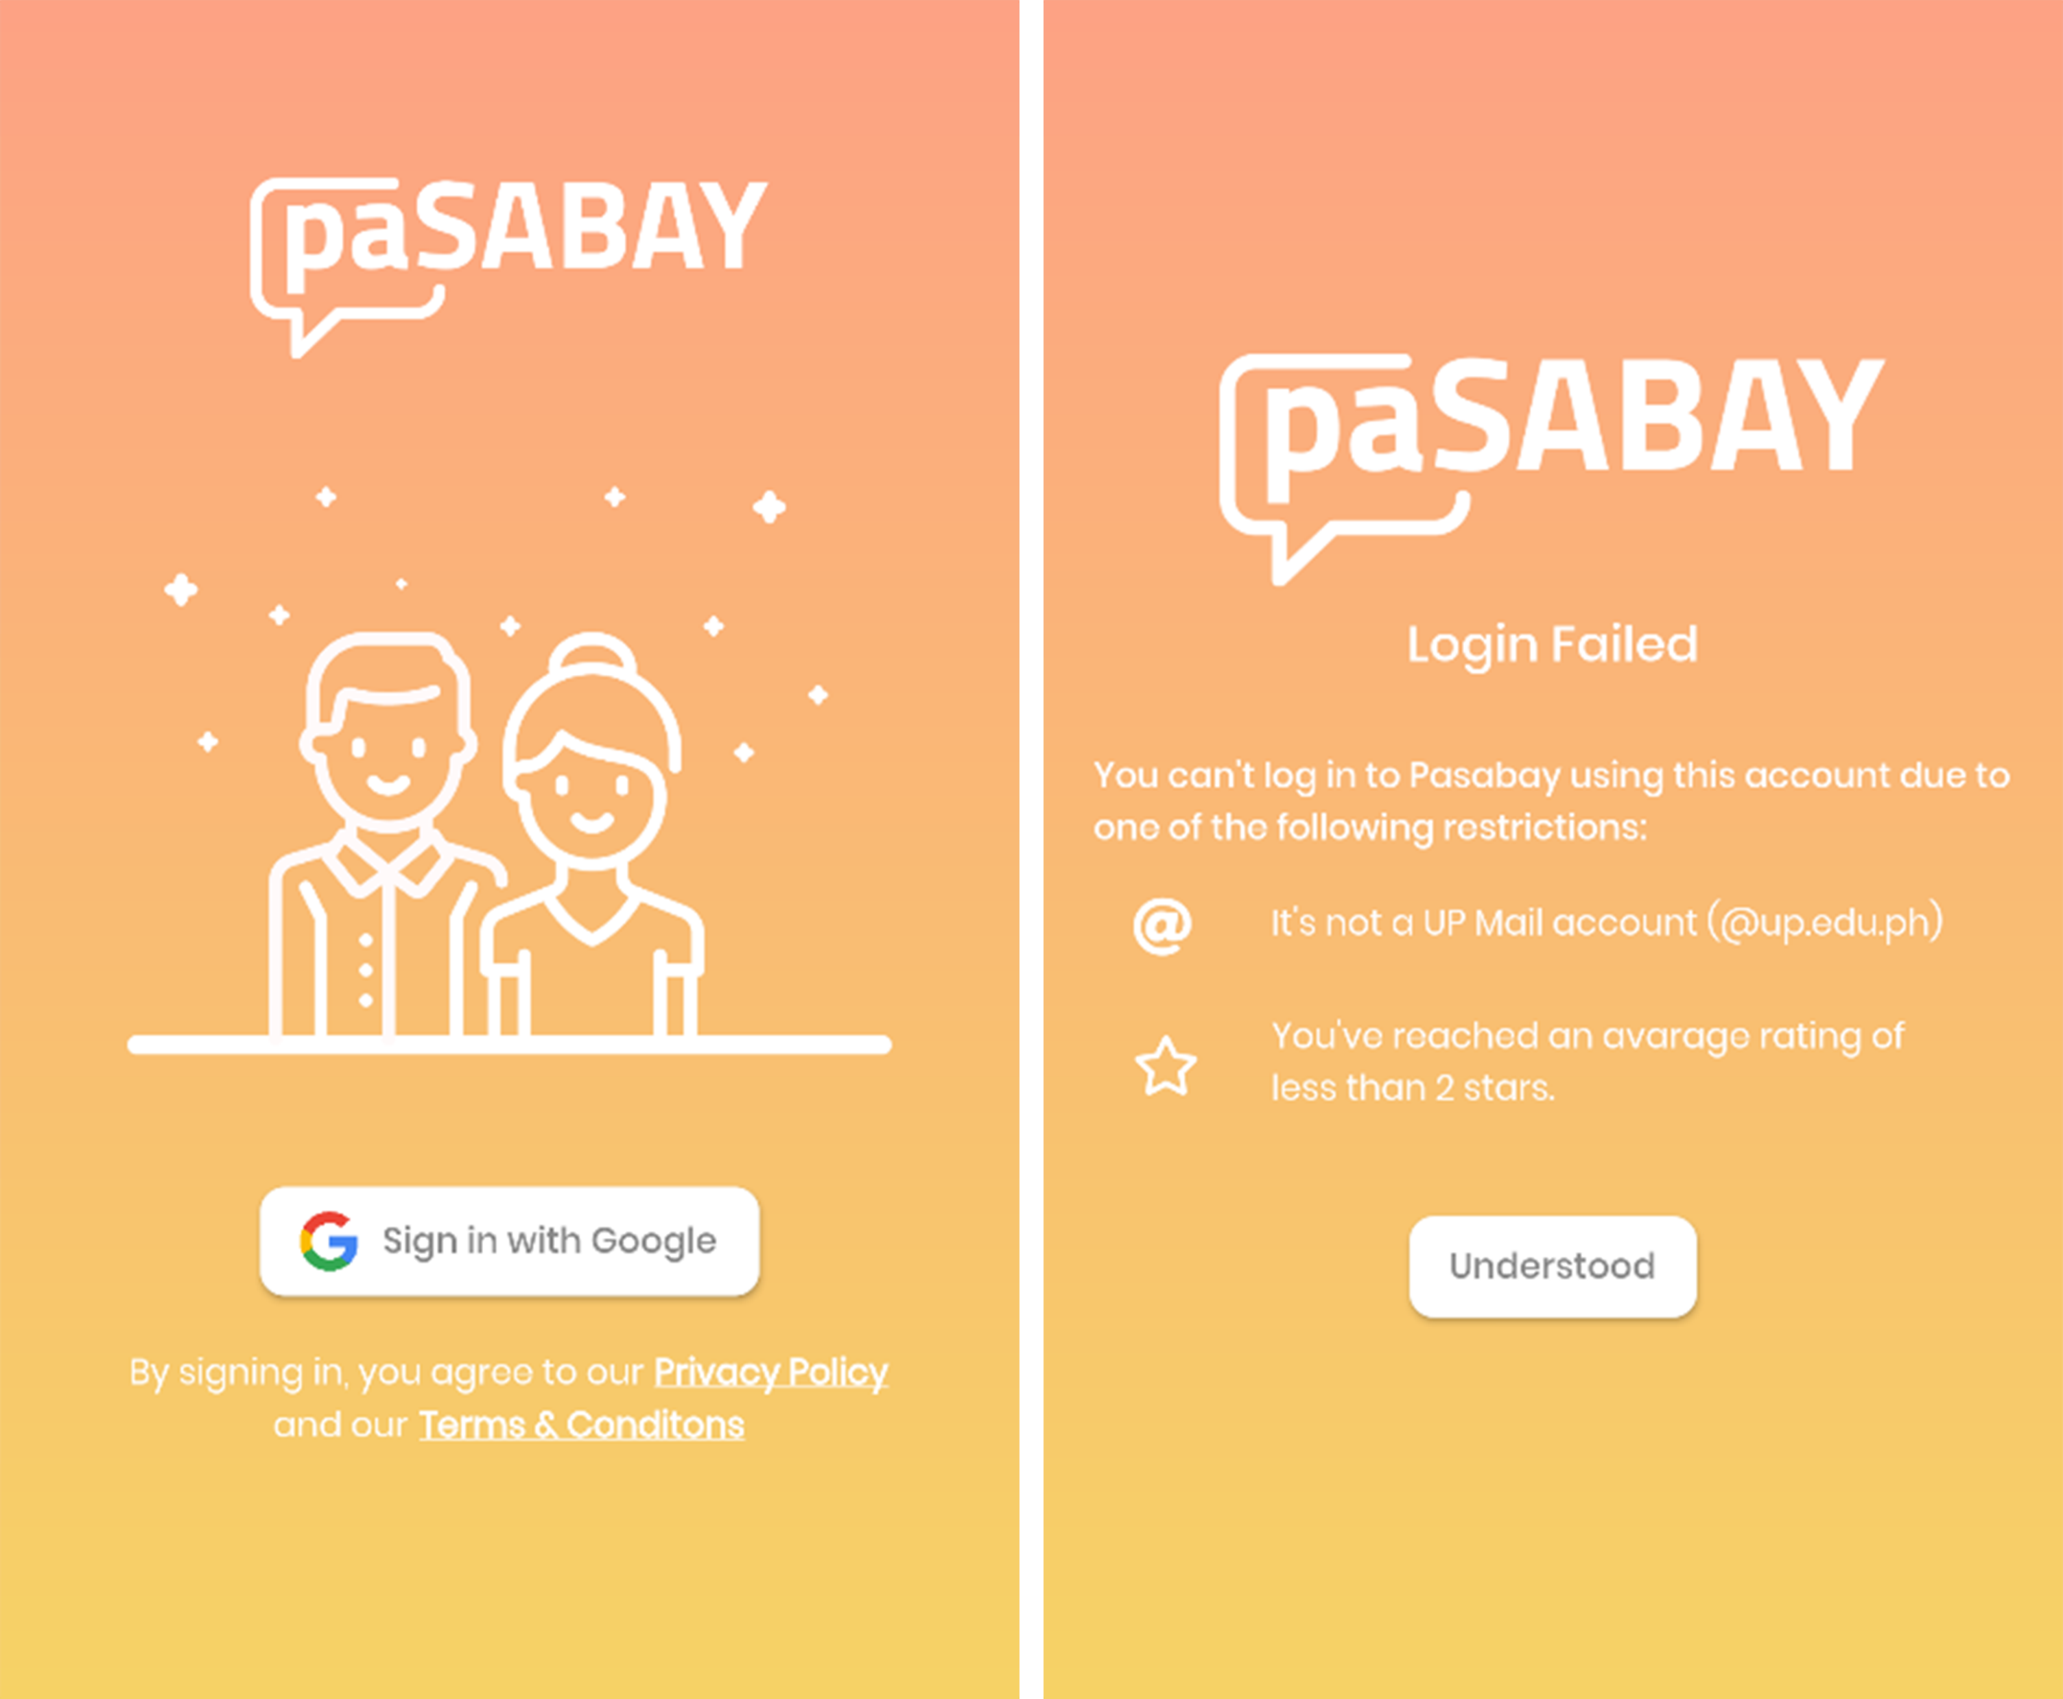
Sign in with Google
This allows users to instantly sign in through the application with the use of their UP Mail account.
Notes:
This allows users to instantly sign in through the application with the use of their UP Mail account. Also, this will serve as a way for the system to verify if they are a bonafide UPLB student or employee, and to eliminate spam user registration.

Slide 10
Sign in with Google
This allows users to instantly sign in through the application with the use of their UP Mail account.
Notes:
This allows users to instantly sign in through the application with the use of their UP Mail account. Also, this will serve as a way for the system to verify if they are a bonafide UPLB student or employee, and to eliminate spam user registration.

Slide 11
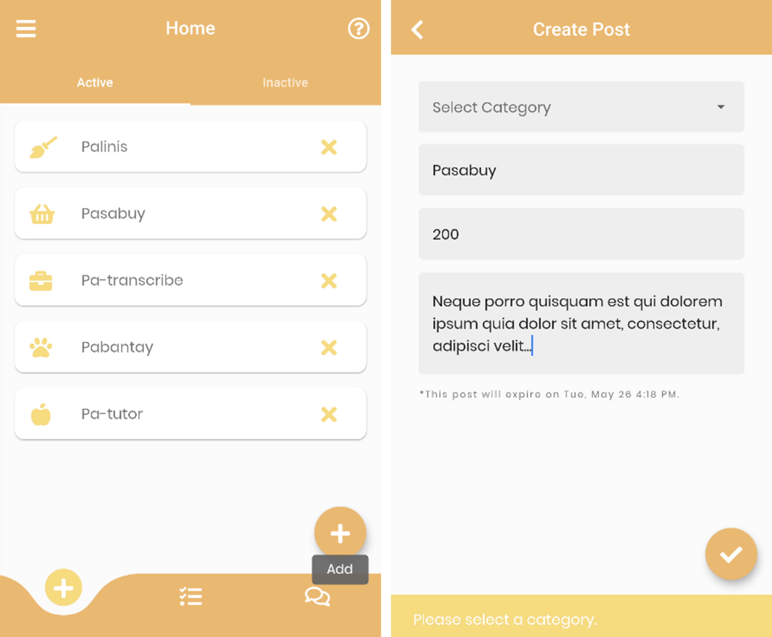
Post Errand
This allows you to post what you need to get done, how to do it, and how much you are willing to pay for it.
Notes:
This allows you to post what you need to get done, how to do it, and how much you are willing to pay for it. All unfulfilled posts will be expired after a week. If users want to renew its expiration date, they just need to edit the post. Users are not allowed to delete posts with existing transactions.

Slide 12
Post Errand
This allows you to post what you need to get done, how to do it, and how much you are willing to pay for it.
Notes:
This allows you to post what you need to get done, how to do it, and how much you are willing to pay for it. All unfulfilled posts will be expired after a week. If users want to renew its expiration date, they just need to edit the post. Users are not allowed to delete posts with existing transactions.

Slide 13
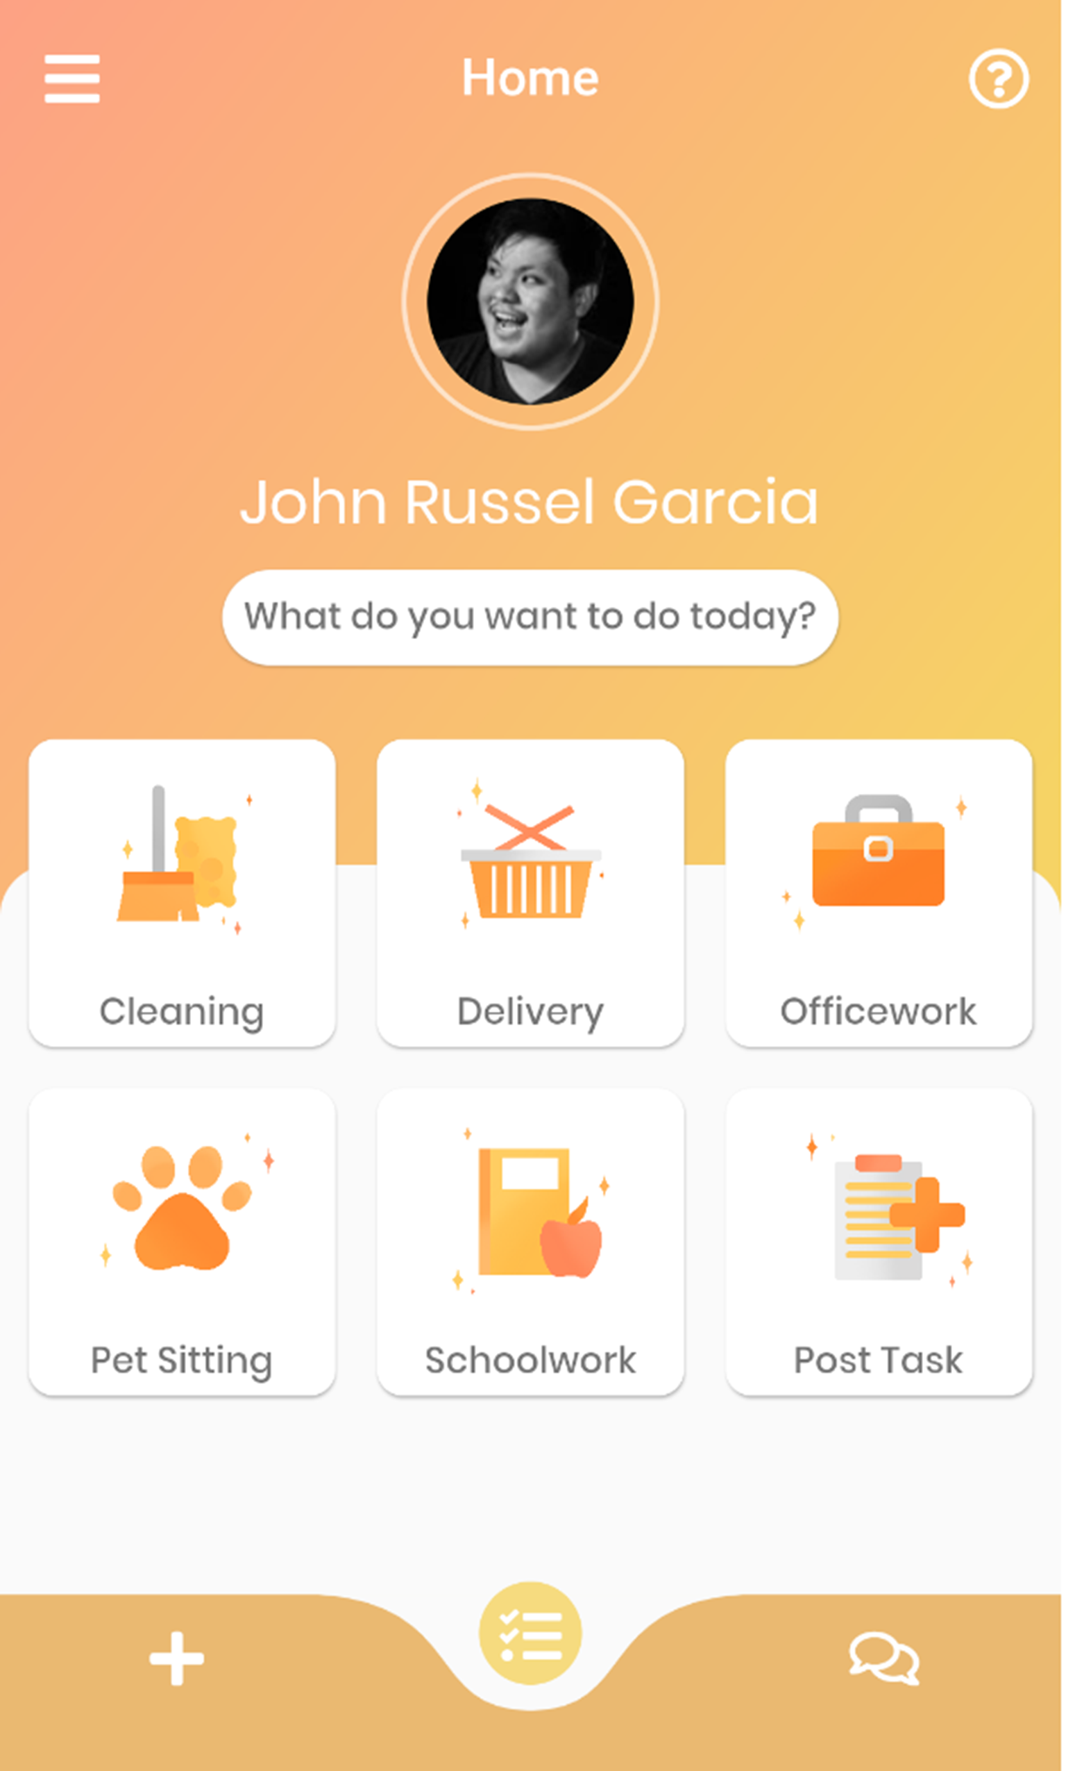
Browse Errands
This allows the user, who is looking for an errand, to search, sort, and filter errands.
Notes:
This allows the user, who is looking for an errand, to search, sort, and filter errands. There are initial categories for a user to choose from.
Cleaning
This service includes sweeping and mopping floors, making beds, tidying, bathroom cleaning, vacuuming, surface cleaning, car washing, laundry and ironing, and following the customer instructions.
Delivery
This service includes purchase and pick-up of desired items, groceries, food or beverages, and delivery of the purchased items to a specified location. Quantity of orders needs to be agreed upon between users before purchasing of items.
Officework
This service is on-site and includes inbound and unbound calls, typing and word processing, operating office machines, filing data entry, office inventory and replenishment, running errands, and following the customer instructions. Customer shall provide the materials, tools, and necessary training for the doer to perform the task.
Pet Sitting
This service includes dog sitting, replenishing of pet food and water, walking dogs in permitted areas, cleaning up after dogs, and playtime.
Schoolwork
This service includes tutoring, editing and proofreading papers, transcribing, editing videos, designing posters, participating in focus group discussions, interviews, or surveys, statistical analysis and the likes. Customer shall provide the materials, tools, and necessary training for the doer to perform the task.
The default sorting algorithm is the most recently posted errand first. Also, there is an in-app search bar that will look into the titles and descriptions of available errands and filter them based on the search keyword.

Slide 14
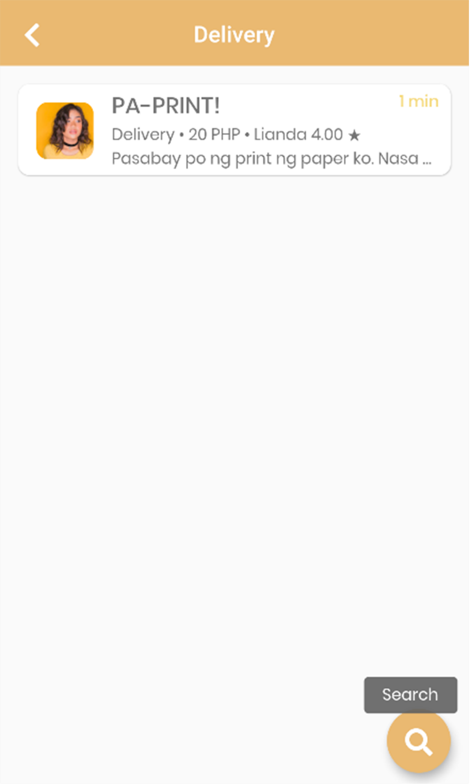
Browse Errands
This allows the user, who is looking for an errand, to search, sort, and filter errands.
Notes:
This allows the user, who is looking for an errand, to search, sort, and filter errands. There are initial categories for a user to choose from.
Cleaning
This service includes sweeping and mopping floors, making beds, tidying, bathroom cleaning, vacuuming, surface cleaning, car washing, laundry and ironing, and following the customer instructions.
Delivery
This service includes purchase and pick-up of desired items, groceries, food or beverages, and delivery of the purchased items to a specified location. Quantity of orders needs to be agreed upon between users before purchasing of items.
Officework
This service is on-site and includes inbound and unbound calls, typing and word processing, operating office machines, filing data entry, office inventory and replenishment, running errands, and following the customer instructions. Customer shall provide the materials, tools, and necessary training for the doer to perform the task.
Pet Sitting
This service includes dog sitting, replenishing of pet food and water, walking dogs in permitted areas, cleaning up after dogs, and playtime.
Schoolwork
This service includes tutoring, editing and proofreading papers, transcribing, editing videos, designing posters, participating in focus group discussions, interviews, or surveys, statistical analysis and the likes. Customer shall provide the materials, tools, and necessary training for the doer to perform the task.
The default sorting algorithm is the most recently posted errand first. Also, there is an in-app search bar that will look into the titles and descriptions of available errands and filter them based on the search keyword.

Slide 15

Browse Errands
This allows the user, who is looking for an errand, to search, sort, and filter errands.
Notes:
This allows the user, who is looking for an errand, to search, sort, and filter errands. There are initial categories for a user to choose from.
Cleaning
This service includes sweeping and mopping floors, making beds, tidying, bathroom cleaning, vacuuming, surface cleaning, car washing, laundry and ironing, and following the customer instructions.
Delivery
This service includes purchase and pick-up of desired items, groceries, food or beverages, and delivery of the purchased items to a specified location. Quantity of orders needs to be agreed upon between users before purchasing of items.
Officework
This service is on-site and includes inbound and unbound calls, typing and word processing, operating office machines, filing data entry, office inventory and replenishment, running errands, and following the customer instructions. Customer shall provide the materials, tools, and necessary training for the doer to perform the task.
Pet Sitting
This service includes dog sitting, replenishing of pet food and water, walking dogs in permitted areas, cleaning up after dogs, and playtime.
Schoolwork
This service includes tutoring, editing and proofreading papers, transcribing, editing videos, designing posters, participating in focus group discussions, interviews, or surveys, statistical analysis and the likes. Customer shall provide the materials, tools, and necessary training for the doer to perform the task.
The default sorting algorithm is the most recently posted errand first. Also, there is an in-app search bar that looks into the titles of available errands and filter them based on the search keyword.

Slide 16
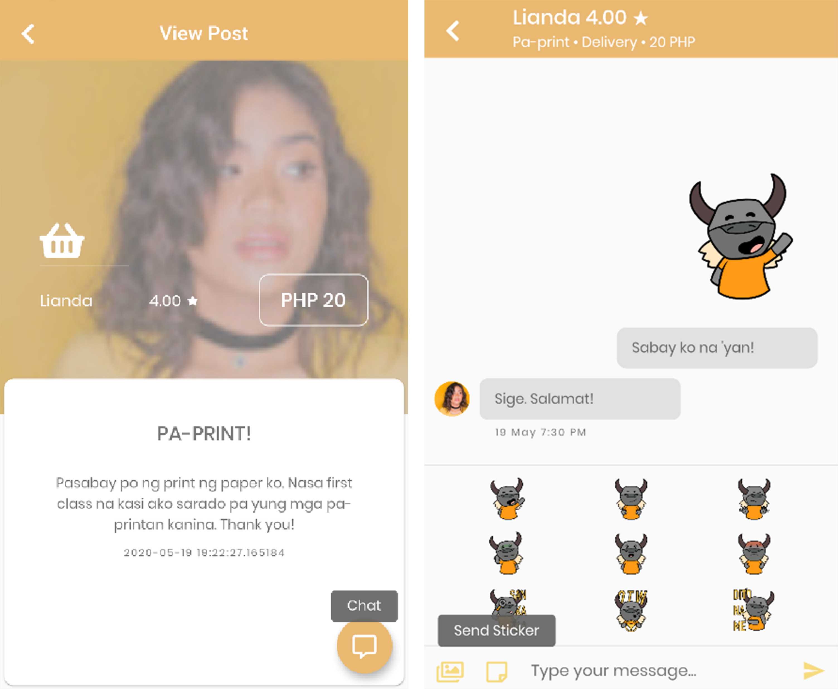
Chat
This allows the users to transact with each other in order to further clarify the scope of selected errand through sending of texts and images.
Notes:
This allows the users to transact with each other in order to further clarify the scope of selected errand through sending of texts and images. Also, push notifications have been added so that users still receive messages even if they are not in the app.

Slide 17
Chat
This allows the users to transact with each other in order to further clarify the scope of selected errand through sending of texts and images.
Notes:
This allows the users to transact with each other in order to further clarify the scope of selected errand through sending of texts and images. Also, push notifications have been added so that users still receive messages even if they are not in the app.

Slide 18
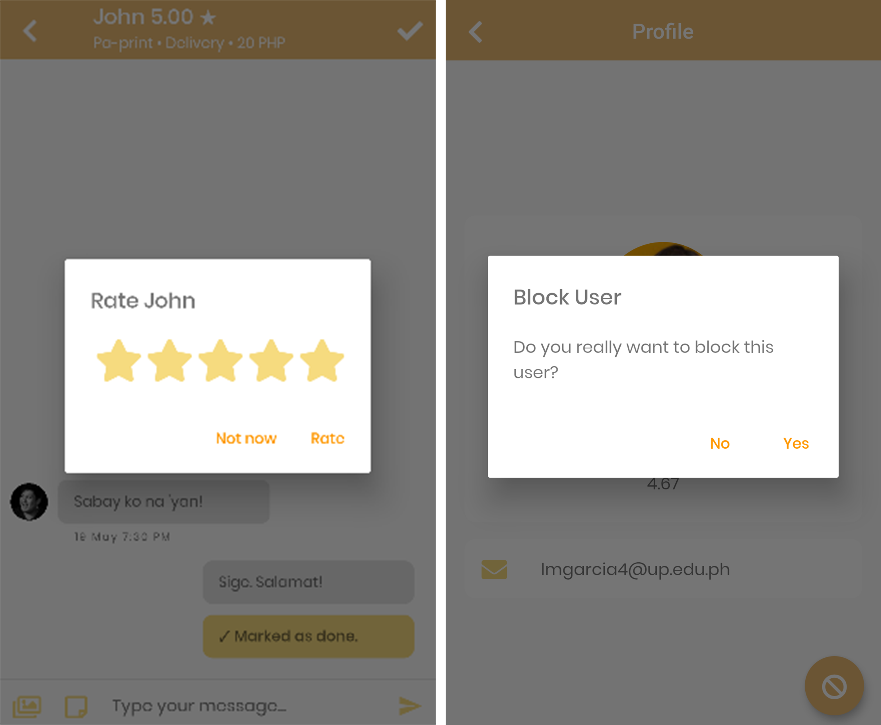
Rate
After an errand is marked as done, you will rate your experience (on a scale of one to five stars) based on the performance of the user who completed the errand and vice versa.
Notes:
After an errand is marked as done, you will rate your experience (on a scale of one to five stars) based on the performance of the user who completed the errand and vice versa. The system will calculate the average based on all the ratings received by the users. Users who have an average rate of less than three will receive constant alert dialog. However, once they reached an average rate of less than two, the system will automatically block them from using the application. They will not be able to log in to the system anymore.

Slide 19
Block
This allows you to block users if you receive unjust treatment from them, including but not limited to, scamming and harassing.
Notes:
This allows you to block users if you receive unjust treatment from them, including but not limited to, scamming and harassing. If you block a user, they cannot see your posted errands and message you. Also, it would terminate any ongoing transaction between you and the user.

Slide 20
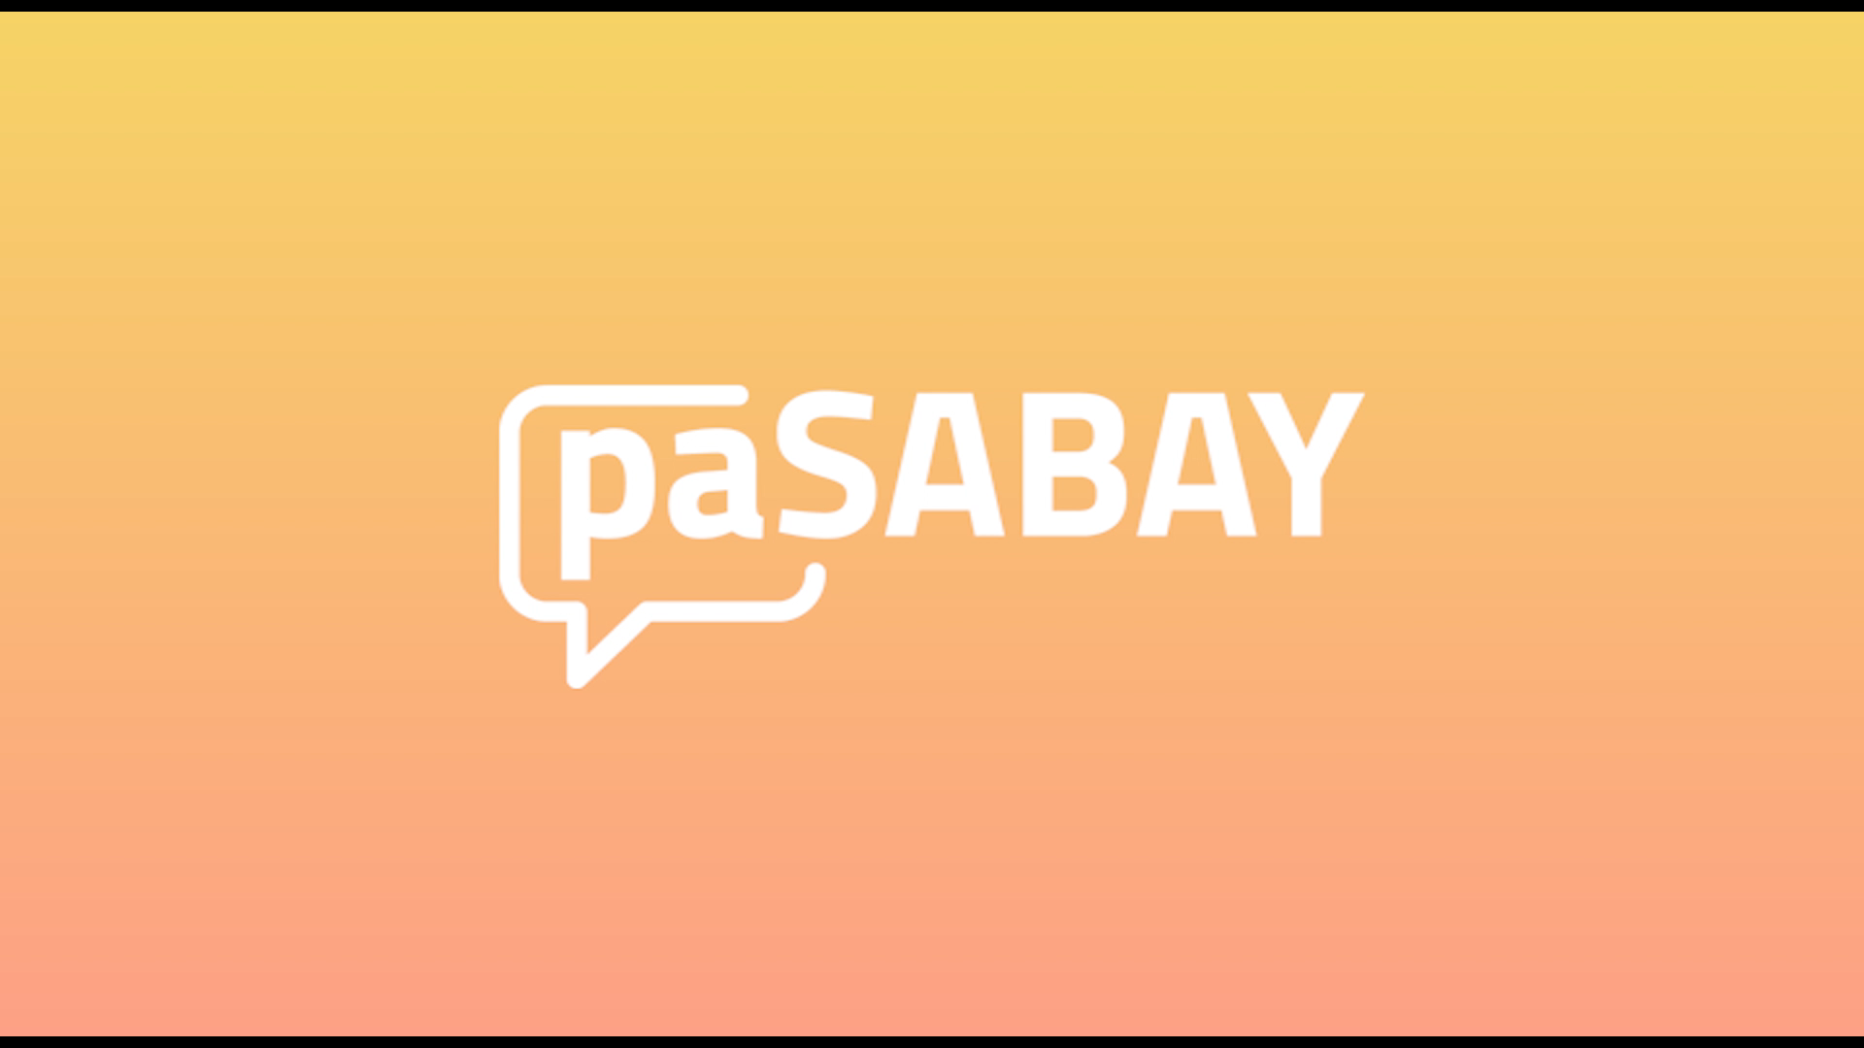
Notes:
To see the app functionalities in action, I’ve prepared a demo video for us to watch.

Slide 21





Development Process
Notes:
The user interface prototype of the mobile application was made using Adobe XD.
For developing the application, the Flutter SDK and Firebase was used along with Visual Studio Code running on the Windows operating system. The application was tested by using the Android Studio's Android emulator, and by connecting an Android smartphone and previewing the app on the device.

Slide 22



User Testing and Survey
PASABAY
MOBILE USERS
SUS
Google Drive
(35 individuals)
Google Forms
Notes:
The installer or the Android Package (APK) of the app was uploaded to Google Drive and distributed to the respondents, and the survey was conducted online using Google Forms. The respondents were requested to install and explore the app on their own before answering the survey. The SUS score of the mobile application from the responses of 35 individuals varied from 65 to 100. The ages of the respondents ranged from 18 to 25, and all of them are bonafide UPLB students from varied courses.

Slide 23
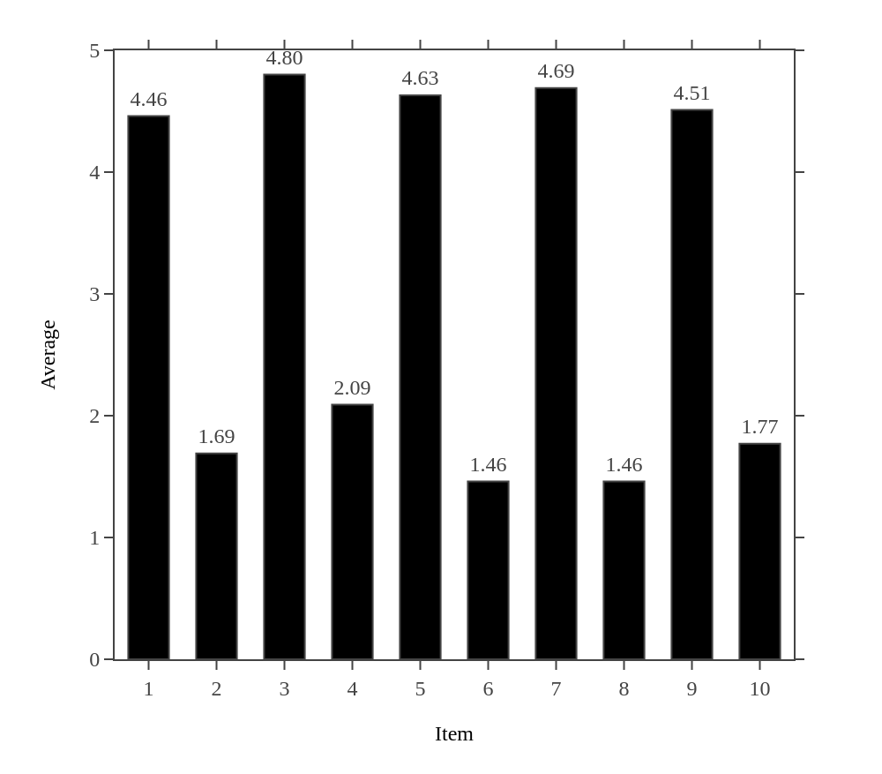
Survey Results
I think that I would like to use this app frequently.
I found the app unnecessarily complex.
I thought the app was easy to use.
I think that I would need the support of a technical person to be able to use this app.
I found the various functions in this app were well integrated.
I thought there was too much inconsistency in this app.
I would imagine that most people would learn to use this app very quickly.
I found the app very awkward to use.
I felt very confident using the app.
I needed to learn a lot of things before I could get going with this app.
Notes:
They were asked to score the following 10 items with one of five responses that range from Strongly Disagree to Strongly Agree:
I think that I would like to use this app frequently.
I found the app unnecessarily complex.
I thought the app was easy to use.
I think that I would need the support of a technical person to be able to use this app.
I found the various functions in this app were well integrated.
I thought there was too much inconsistency in this app.
I would imagine that most people would learn to use this app very quickly.
I found the app very awkward to use.
I felt very confident using the app.
I needed to learn a lot of things before I could get going with this app.
The average score for each item is shown in the figure and based on the top three highest scored items on the survey results, most of them thought that the app was easy to use, would imagine that most people would learn to use the app very quickly, and found the various functions in the app were well integrated.
It is also worth mentioning the comments of the respondents regarding the UI being simple, clean, and pleasing to the eye. However, a very few respondents reported that some parts of the UI are not showing properly due to the small screen of their devices even if the UI is responsive. Also, some of the respondents suggested to add features such as payment methods and locations, and to improve functionalities on the Chat page.

Slide 24
SUS Score: 87.7
Awful | Poor | Okay | Good | Excellent
< 51 | 51 - 68 | 68 | 68 – 80.3 | > 80.3
Notes:
The average SUS score is 68. Whereas an average of 87.7 SUS score was computed for the mobile application based on the survey results. Therefore, the SUS score for the mobile application landed on the above average mark. Since the overall SUS score of the mobile application is 87.7, the user-experience of the mobile application is considered Excellent based on the general guideline on the interpretation of SUS score.

Slide 25





Recommendations
Notes:
The developer recommends creating
a real-time location update so that the user knows the location and proximity of the other user. To avoid any privacy issues, upon installing the app, it should initially ask permission to enable the user’s location upon installing it for the better use of the application. It should also be clarified and assured that the location details will not be in public. Rather, it will only be visible upon the transaction of two users.
It is also noteworthy to have a recommender system that will recommend users to do posted errands that are based on their activities inside the app.
A matching algorithm that will suit a user to another user that can immediately finish and complete errands may also be added to further enhance the user experience.
Having a Settings page where users can choose color themes, font type, and font size might improve the overall user experience since it allows users to customize the UI based on their preferences.
Furthermore, adding a Share button to different social media platforms would help users to disseminate their posts and to also publicize the app itself.

Slide 26
Thank You!

Slide 27
Notes:
Scope and Limitation
The study limited its scope to the creation of a mobile application to the UPLB area only. The test and use of the application were limited solely to UPLB students and employees who have access to their UP Mail accounts. The direct transaction and dealings of the application users were beyond the coverage of the study as it only focuses on creating a standard platform where the users can interact. It was published and released for public use and consumption.
Moreover, an application developed in Flutter can work on both Android and iOS. However, the developed mobile application was only tested through Android smartphones due to the lack of macOS platform at hand. Therefore, its compatibility with a tablet and iOS is not guaranteed.

